Slide 1
FACE MASK DETECTION SYSTEM
Presented by
Arunraj M - 2018103011
Mohamed Abdul Malik J - 2018103043
Gobinath A L - 2018103025
DATE : 01/11/2020
Miniproject as part of Machine Learning - CS6301

Slide 2
Objective
In these tough COVID-19 times, wouldn’t it be satisfying to do something related to it?
So we decided to build a very simple and basic Convolutional Neural Network (CNN) model using TensorFlow with Keras library and OpenCV to detect if you are wearing a face mask to protect yourself.
Our system consists of a dual stage Convolutional Neural Network (CNN) architecture capable of detecting masked and unmasked faces and can be integrated with pre-installed CCTV cameras.
This will help track safety violations, promote the use of face masks, and ensure a safe working environment.

Slide 3
Introduction
This project named “Face Mask Detection System” can detect a person in real-time if he/she is wearing a mask or not using CCTV camera with quite a good accuracy. After that, he/she is denied access to places where authorities have strictly asked to wear the face mask. After denying access to the person, authorities will get an alert email in real-time where the person’s photo will be attached. May be screen panels could be installed at the entrances where a person when denied can see a pop-up Warning Message where he/she would be advised to wear a mask before getting access. This project will be useful during the times of pandemic when people will be suggested to wear a mask when going in public. Wearing a face mask is a new norm today when going in public. It is very important to wear the mask to restrict the spread of virus.

Slide 4
Problem Description
In this new era where we experiencing a pandemic and people all around are advised to wear masks, some people are not used to it and are avoiding to wear masks. The motivation behind this projects is that if we can take help of AI to detect people wearing or not wearing masks in public places, it would be helpful to increase our safety. If deployed correctly, the mask detector could potentially be used to help ensure our safety.
Also, it is very depressing to be alive in this period, to witness so much happening in this world, I decided why not do something out of it i.e convert a real world problem in which we humans have to wear masks to go out, into a Machine Learning problem.
The task here is to predict people wearing masks or not wearing them, given an image or a video. It is an object detection and classification problem with 2 different classes(Mask and Without Mask).

Slide 5
System Architecture
Data visualization
Data splitting
CNN model builder
Dataset
Email authorities
Facemask detection predictor
Training CNN model

Slide 6
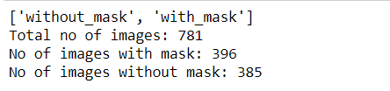
Data visualization - Module 1
Input:
Dataset containing images with and without masks
Output:
Number of images in the dataset with and without masks

Slide 7
Data visualization - Module 1
Algorithm:
Import necessary modules
Path = directory containing the dataset folder
For each folder in the path:
Count no of images in the folder
Print folder name and count

Slide 8
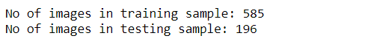
Data splitting - Module 2
Input :
Dataset containing images with and without masks
Output :
Training and testing set

Slide 9
Data splitting - Module 2
Algorithm:
Import necessary modules
Set img_row and img_cols as 112,112
Initialize 2 empty lists images[] and labels[]
For each category in dataset:
Read the image
Convert image to grayscale
resize the gray scaled image into size 56x56 in order to keep size of the images consistent
Handle the exception in case any error occurs
Perform one hot encoding on the labels list
Call train_test_split function
Print no of imges in training and testing dataset

Slide 10
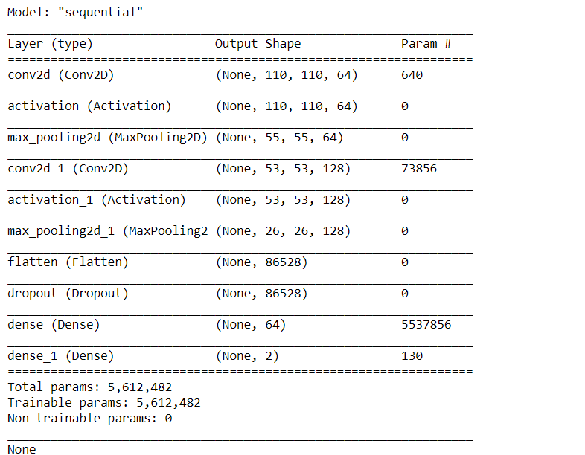
CNN Model Builder - Module 3
Input:
Parameters for CNN
Output:
CNN Model

Slide 11
CNN Model Builder - Module 3
Algorithm:
Import necessary keras libraries
Define model parameters:
No of classes
Batch size
Use sequential API for model building
Create first and second layer groups containing the layers:
Convolutional
RelU
Maxpooling
Flatten and Dropout Layer to stack the output convolutions above as well as cater overfitting
Apply softmax classifier
Print summary of the model

Slide 12
Training CNN Model - Module 4
Input:
CNN Model, training and testing data
Output:
Trained CNN model

Slide 13
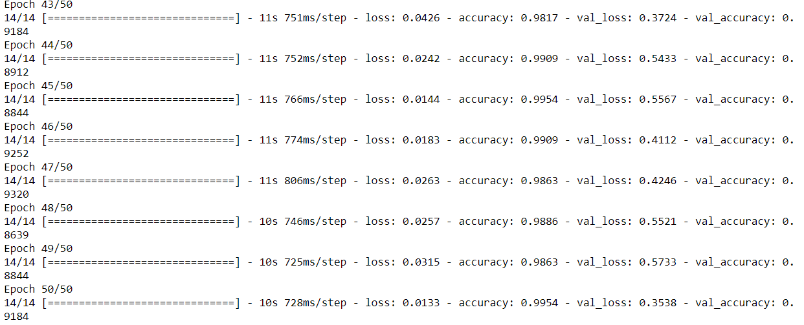
Output of Module 4

Slide 14
Training CNN Model - Module 4
Algorithm:
Import adam optimizer from keras library
Set the preferred no of epochs
To train the model:
Use model.compile function from keras library and set the following parameters:
loss = 'categorical_crossentropy'
optimizer = Adam(lr=0.001),
metrics = ['accuracy']
Fit the model using model.fit function provided by keras

Slide 15
Facemask Detection Predictor - Module 5
Input:
Trained CNN model and live video feed
Output:
Classification of person with and without mask

Slide 16
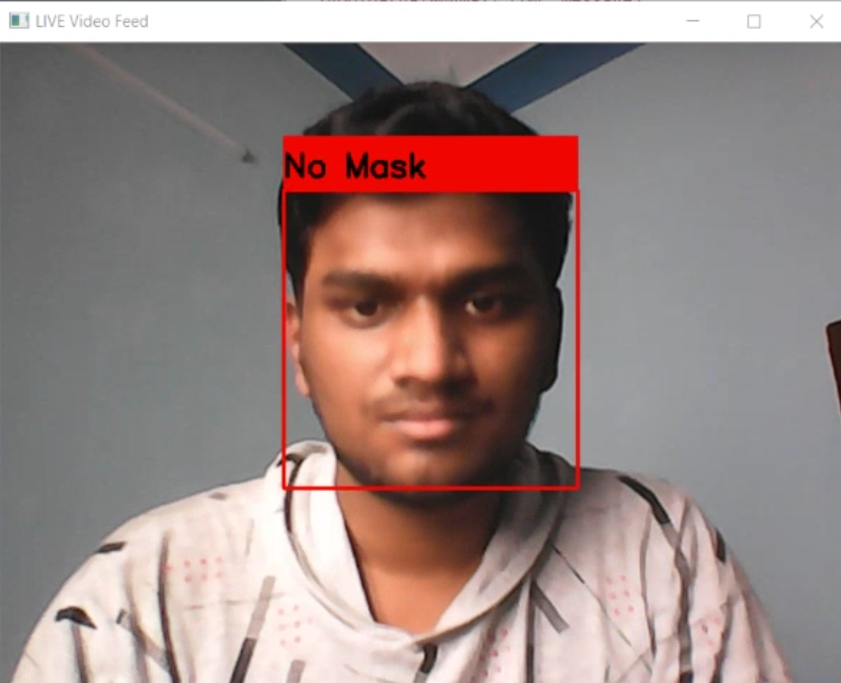
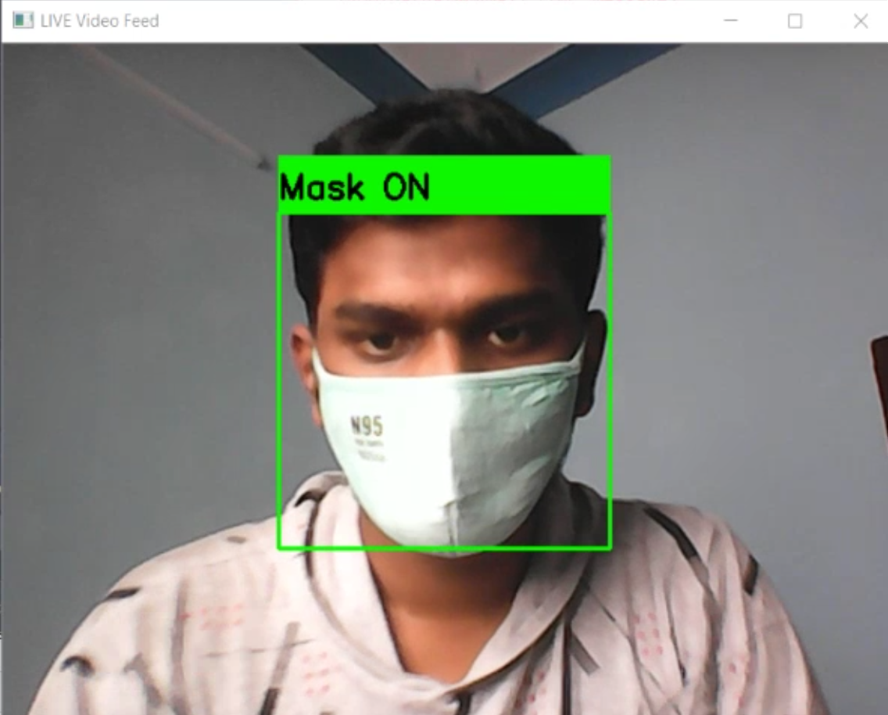
Output of Module 5

Slide 17
Facemask Detection Predictor - Module 5
Algorithm:
Load the trained CNN model
Maintain 2 dictionaries:
text_dict={0:'Mask ON',1:'No Mask'}
rect_color_dict={0:(0,255,0),1:(0,0,255)}
Loop forever:
Read the image from webcam
Convert to grayscale
Resize the image to 112x112
Normalize the image
Reshape the image to (1,112,112,1)
Result = predictor(reshaped_image)
If label == 1:
Print ‘No Mask’
Else:
Print ‘mask ON’

Slide 18
Email authorities - Module 6
Input : predicted class
Output : email
Algorithm:
Connect to email using smtp library
Login and send email
Close connection

Slide 19

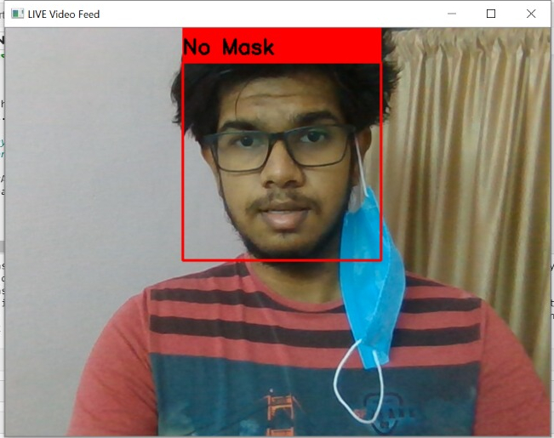
Output of module 6

Slide 20
Experimental Results
Dataset used:
We have used the face mask dataset provided by Prajna Bhandary
Link : https://drive.google.com/drive/folders/1hmetIOPL2__lZPj5k8oDdgG_6QkX680h?usp=sharing
Description:
It consists of about 781 labelled images with 396 images containing people with face masks and 385 images containing people without face masks
The label indicates if a person in the image is wearing a mask or not

Slide 21

Experimental Results
Screencapture of experimental results
Video link: https://drive.google.com/file/d/1KMNMPD8b9puo86dU47VQwZFa3T00nNcq/view?usp=sharing

Slide 22
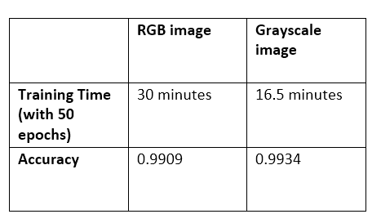
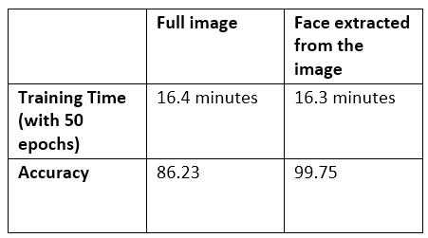
Experimental Results
Analytical ablation study
Using grayscaled images for computation resulted in 45% increase in performance and almost same accuracy when using rgb images
Using only the person’s face in the image for training the model resulted in 13.5% increase in accuracy

Slide 23
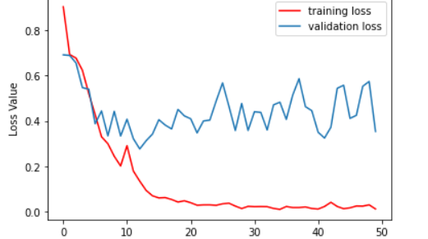
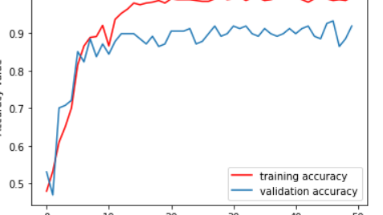
Performance metrics

Slide 24
Conclusion
As the technology are blooming with emerging trends the availability so we have novel face mask detector which can possibly contribute to public healthcare. The architecture consists of CNN as the backbone it can be used for high and low computation scenarios. I do hope that these tough times come to an end soon. Let us all stay healthy and be safe.

Slide 25
References
VINITHA V, VELANTINA V “COVID-19 FACEMASK DETECTION USING DEEP LEARNING AND COMPUTER VISION”, AUG 2020
Link: https://drive.google.com/file/d/1qDfnlewG16d56Jys4WpBAcWyiYRYwBKU/view?usp=sharing
MINGJIE JIANG, XINQI FAN, HONG YAN “RETINA FACEMASK - A FACEMASK DETECTOR”, JUN 2020
Link: https://drive.google.com/file/d/1zD-rN0FCibVAB-ylcjlIsyyy7dtYwtlq/view?usp=sharing

